Slide 1
Python for Excel Users
Nicole Lettich
People Analytics World |April 2022

Slide 2

Agenda
Introduction
Navigating a Data Frame
Exploring Your Data
Selecting Data
Cleaning Data
Data Visualizations
This Photo by Unknown author is licensed under CC BY-SA.

Slide 3

BIO
As an Organization Insights and Analytics Leader in Nasdaq's People@Nasdaq organization, Nicole Lettich is responsible for transforming data to generate insights and inform business decisions. She is an avid Python coder who is dedicated to using data and analytics to positively impact the employee career journey. Prior to joining Nasdaq, she has held roles in Human Resources, Operations and Marketing Analytics for companies including NRG Energy, US Construction Inc., and JPMorgan Chase

Slide 4
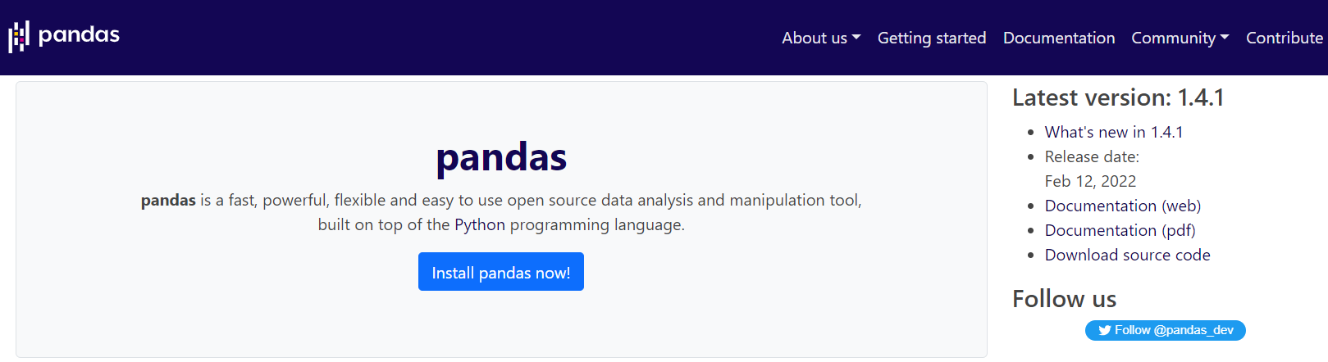
About pandas
The easiest way to install pandas is using the Anaconda package manager -includes python, pandas and key data viz packages
pandas can import a variety of file formats including Excel and CSV

Slide 5
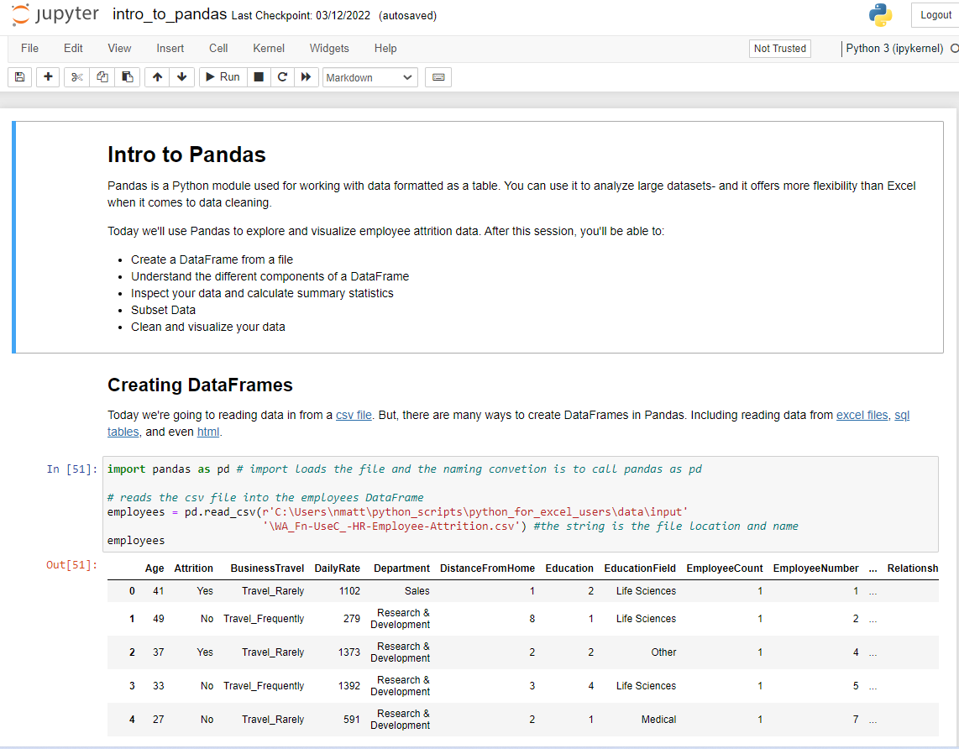
Jupyter Notebook
Web application for sharing code, notes and data visualization

Slide 6
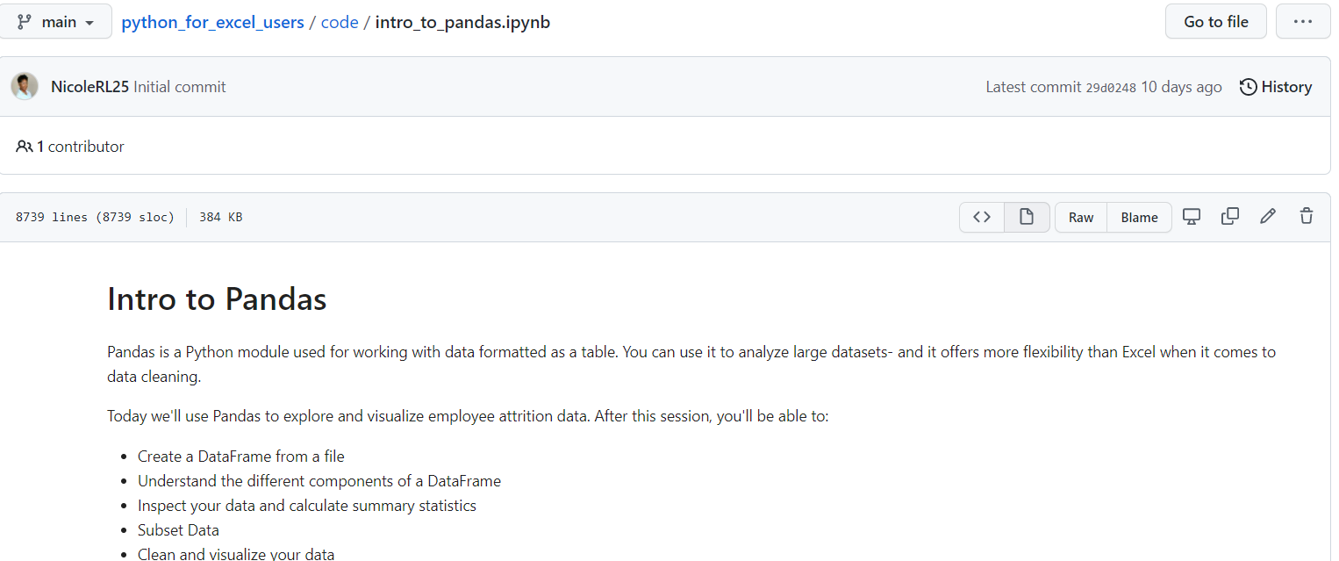

GitHub
GitHub.com is an online code repository that works with git version tracking software
Download Jupyter Notebook here:
Click Raw
Ctrl + S to Save
Save file name with .ipynb suffix as Type All Files
Download the data here

Slide 7
Agenda
Introduction
Navigating a Data Frame
Exploring Your Data
Selecting Data
Cleaning Data
Data Visualizations
This Photo by Unknown author is licensed under CC BY-SA.

Slide 8
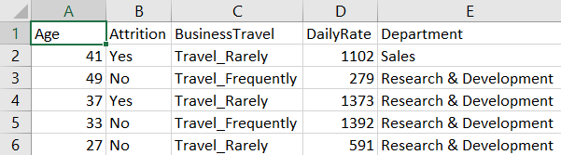
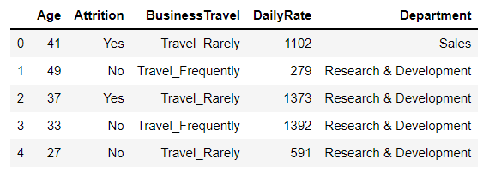
Pandas Data Structures vs Excel Tables
Excel Worksheet
Pandas DataFrame

Slide 9
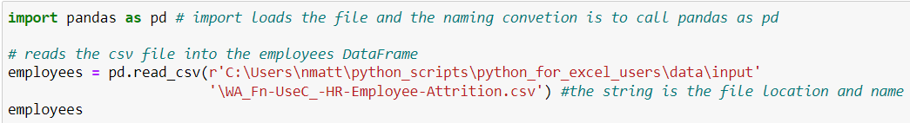
Creating DataFrames
pandas works with all different file types
It only takes one line of code to read data into a pandas DataFrame
File imports can be customized

Slide 10

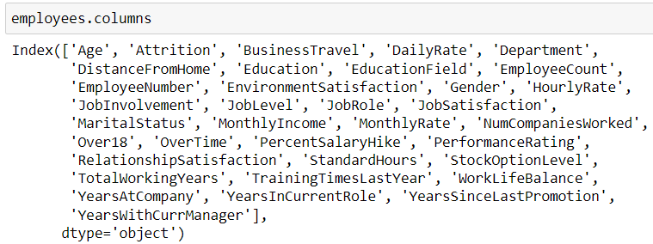
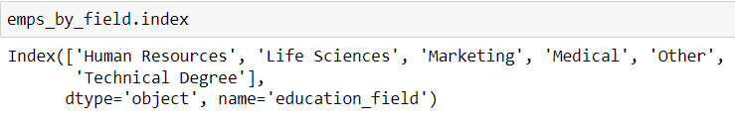
DataFrame Attributes
With pandas, you can access information about the rows and columns using attributes

Slide 11
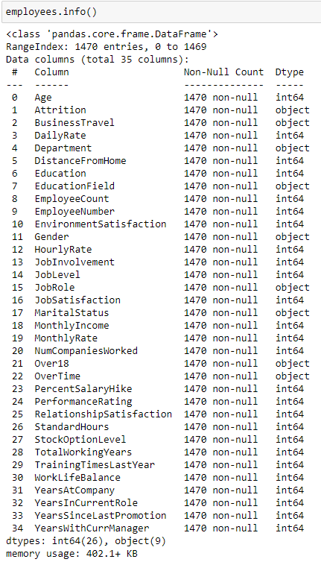
.info()
The .info() method returns the same information you saw with those attributes plus some additional information about the fields

Slide 12
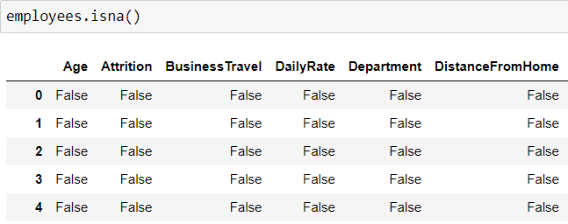
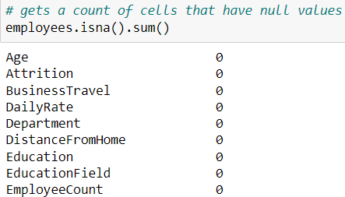
Finding Null Values
A large number of missing values is a sign of poor data quality
It’s important to check and address null values before performing your analysis
With method chaining, you can combine the .isna() method and the .sum() method

Slide 13
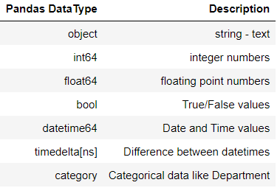
DataTypes
DataTypes are a way of classifying the type of information that a variable holds.

Slide 14
Agenda
Introduction
Navigating a Data Frame
Exploring Your Data
Selecting Data
Cleaning Data
Data Visualizations
This Photo by Unknown author is licensed under CC BY-SA.

Slide 15
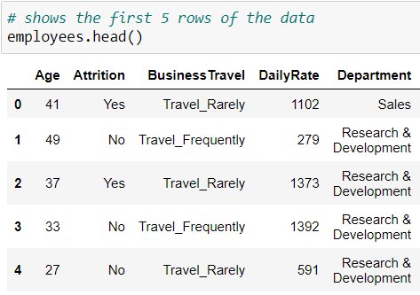
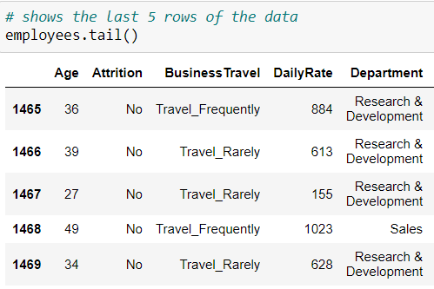
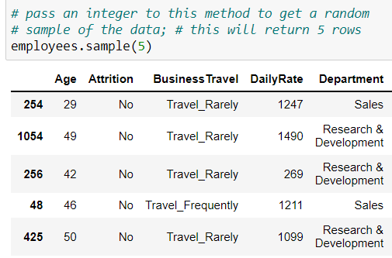
Viewing Your Data
.head()
.tail()
.sample()

Slide 16
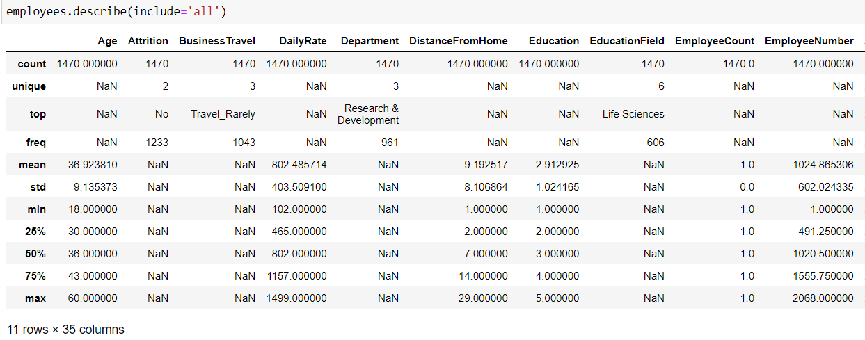
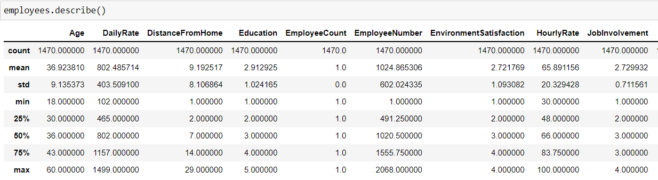
Summary Statistics
.describe() method calculates statistics for all of the numerical values

Slide 17
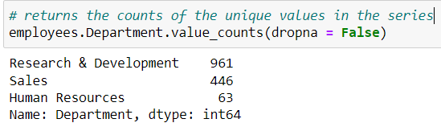
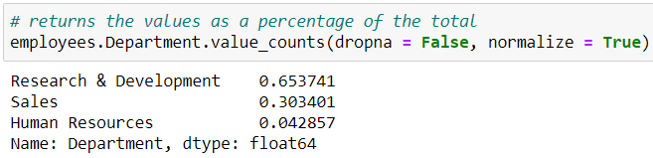
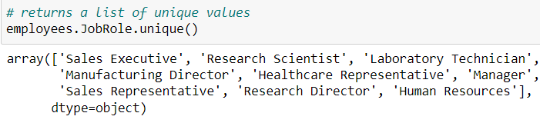
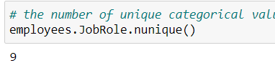
Counts of Categorical Data
.value_counts()
.value_counts(normalize = True)
pandas has a number of functions for working with categorical data that help you explore your series in more depth
.nunique()
.unique()

Slide 18
Agenda
Introduction
Navigating a Data Frame
Exploring Your Data
Selecting Data
Cleaning Data
Data Visualizations
This Photo by Unknown author is licensed under CC BY-SA.

Slide 19


Selecting Columns
You must use bracket notation when the column name:
Includes a space
Matches a pandas DataFrame method (ex. count)
Matches a restricted python word (ex. class)
Is stored in a variable
Is an integer
And:
When creating new columns
When selecting multiple columns
Bracket notation

Slide 20
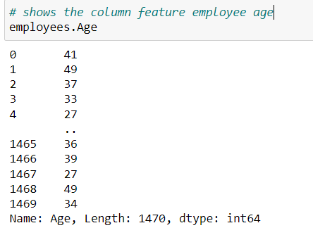
Selecting Columns
Dot notation treats the column like an attribute of the DataFrame
Dot notation

Slide 21
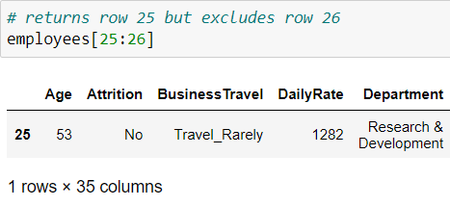
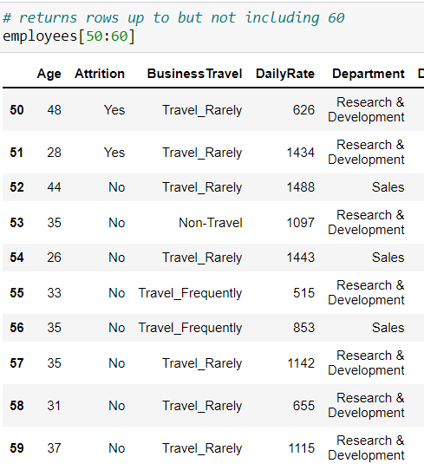
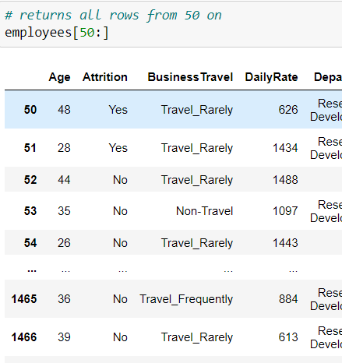
Selecting Rows
DataFrame rows can be sliced using bracket notation: DataFrame[start : stop : step]
The stop value is excluded
The default step is one
Can specify start or stop
A Single Row
A Range of Rows
All Rows from 50

Slide 22
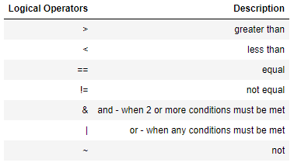
Boolean Indexing
Finds all the rows that meet a given condition
Similar to filtering in Excel
Uses logical operators to build conditional statements

Slide 23
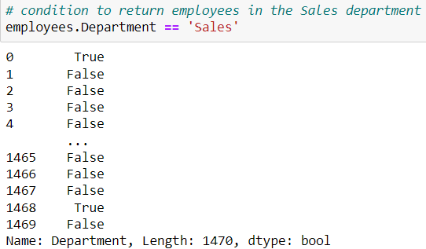
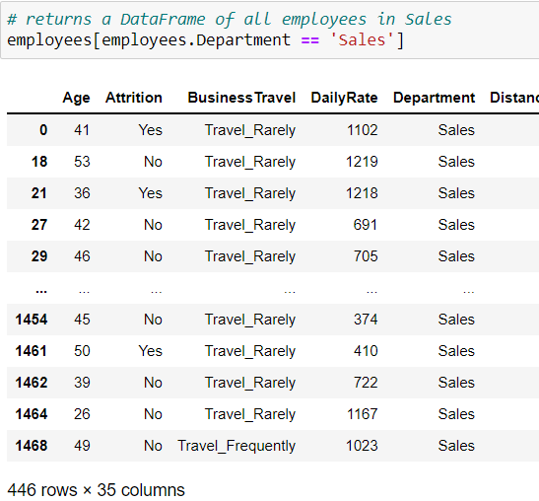
Selecting Sales Employees
For example, if you want to find all of the employees who work in the Sales Department you will need to:
Write the condition
Include the condition in your selection brackets
Using Boolean Indexing
Adding Bracket Notation

Slide 24

Boolean Indexing
Sales Employees AND Job Satisfaction
HR Department OR Sales
Can be used with multiple conditions
& is used when both conditions must be bet
| is used when either condition must be met
~ is used to negate a condition
NOT in the R&D Department
Sales Department or Travel Frequently

Slide 25
Advanced Filtering with .iloc[] and .loc[]
.iloc[] and .loc[] are used to filter DataFrame rows and columns at the same time
Can be used to filter a range of rows/columns or individual rows/columns
Rows and columns can be sliced using [start : stop : step] or python lists
The syntax for using .iloc[] and .loc[] is the same:
DataFrame.loc[[start : stop : step], [start : stop : step]]
OR
DataFrame.iloc[[list of rows], [list of columns]]
Row Slice
Column Slice
Row Index/List
Column Index/List

Slide 26

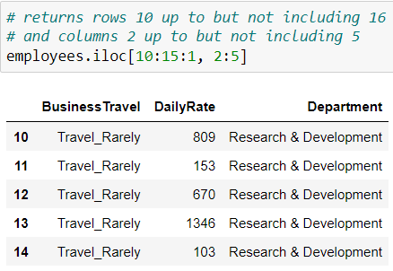
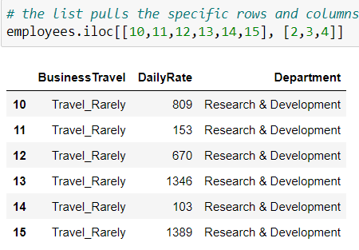
.iloc[]
A Single Value
Using Slice Notation
Using Lists

Slide 27
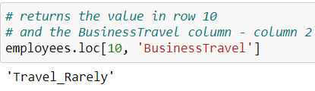
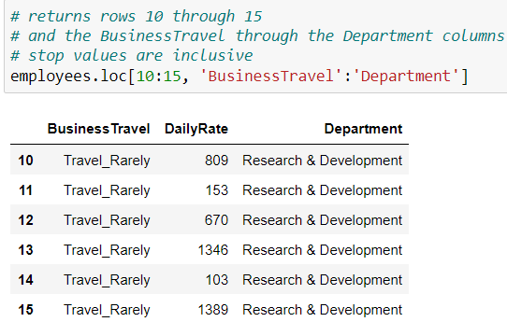
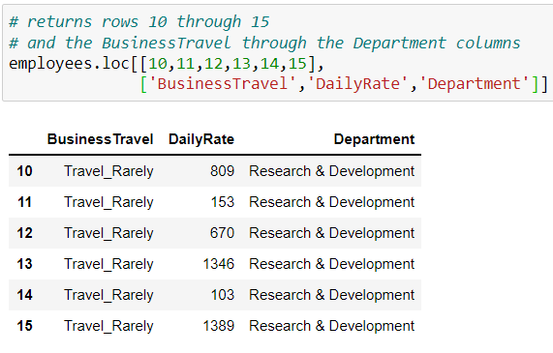
.loc[]
A Single Value
Using Slice Notation
Using Lists

Slide 28
Agenda
Introduction
Navigating a Data Frame
Exploring Your Data
Selecting Data
Cleaning Data
Data Visualizations
This Photo by Unknown author is licensed under CC BY-SA.

Slide 29
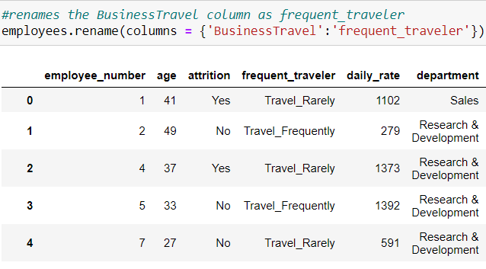

.rename()
Can rename columns and indices using a python dictionary
Use the columns parameter to rename columns and the index parameter to rename index values
python Dictionaries
Using Dictionaries to Rename Columns
The syntax for a python dictionary is:
{key : value}
.rename() uses the dictionary to map the original value to the new value using the key

Slide 30

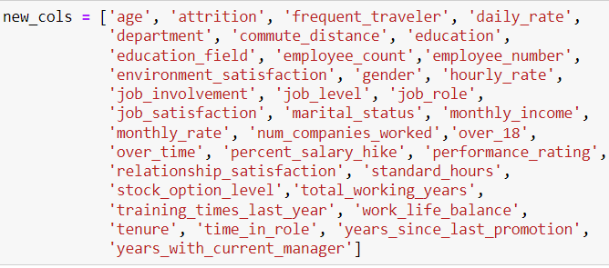
Renaming All Columns
You can replace the names of all columns using a Python list
Python Lists
Replacing All Column Names
The syntax for a python list is:
[value1, value2, value3]

Slide 31
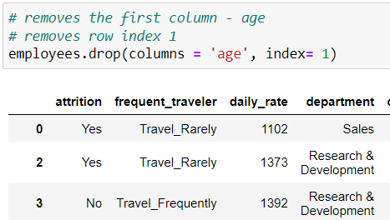
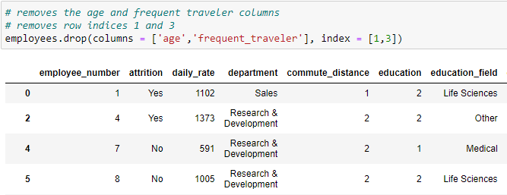
.drop()
Removes any unnecessary columns or rows
Can be used to remove a single column/row or a list of columns/rows
Use one line of code to remove both rows and columns
Dropping One Value
Dropping a List of Values

Slide 32


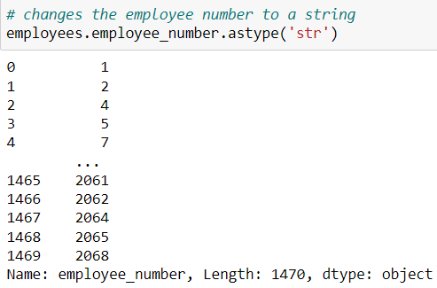
.astype()
Can convert the DataType of a pandas column to another type
Change Integer to a String
Store Changes
OR

Slide 33
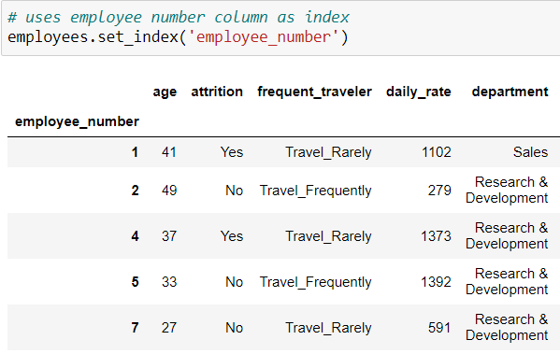
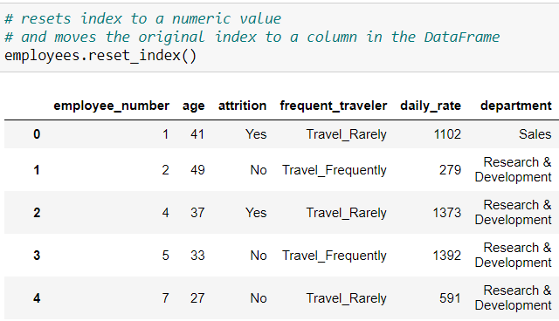
Modifying the Index
.set_index() lets you convert any column to the index
.reset_index() reverts the index back to a numerical range index
Setting the Index
Resetting the Index

Slide 34
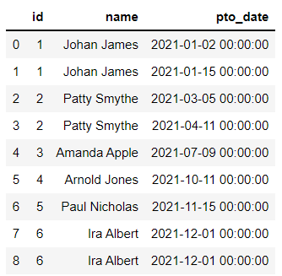
Duplicate Values
.duplicated() is used to find duplicate values
.drop_duplicates() is used to remove duplicate values

Slide 35
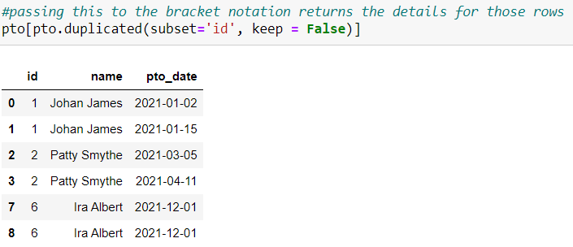
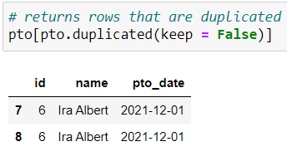
.duplicated()
Finds duplicated values in a DataFrame
The subset parameter looks for duplicates in a single column or list of columns
Without subset, the method returns rows that are duplicated
Finding Duplicates in a Single Column
Finding Duplicate Rows

Slide 36
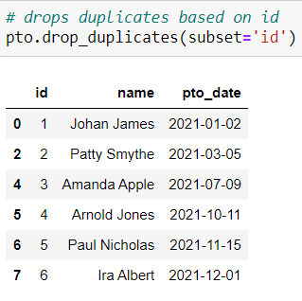
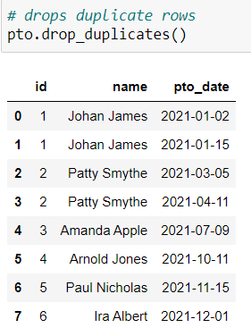
.drop_duplicates()
Drops duplicate values from a DataFrame
Also has a subset parameter to drop_duplicates based on a single column or the entire row
The keep parameter defaults to keeping the first value; False removes all duplicated values
Drop Duplicates Based on a Single Column
Drop Duplicate Rows

Slide 37
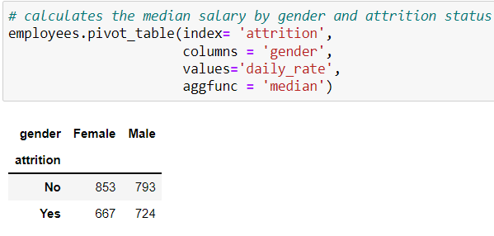
.pivot_table()
Creates an Excel style pivot table
.pivot_table() arguments
Calculates the Median Daily Rate by Attrition Status and Gender
values = columns to aggregate
index = a column or columns which will be the pivot tables index
columns = a column or columns which will be the pivot tables columns
aggfunc = function to use for aggregating the values

Slide 38
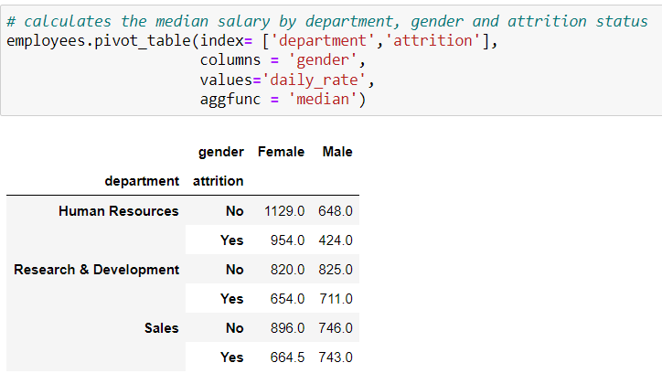
.pivot_table()
Can use python lists to get the same information by Department
.pivot_table() arguments
Calculates the Median Daily Rate by Department, Attrition Status and Gender
values = columns to aggregate
index = a column or columns which will be the pivot tables index
columns = a column or columns which will be the pivot tables columns
aggfunc = function to use for aggregating the values

Slide 39
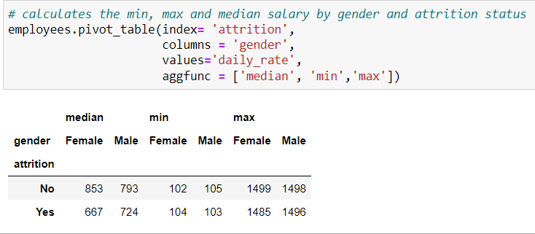
.pivot_table()
Can aggregate the same field multiple ways
.pivot_table() arguments
Calculates the Min, Max, and Median Daily Rate by Attrition Status and Gender
values = columns to aggregate
index = a column or columns which will be the pivot tables index
columns = a column or columns which will be the pivot tables columns
aggfunc = function to use for aggregating the values

Slide 40
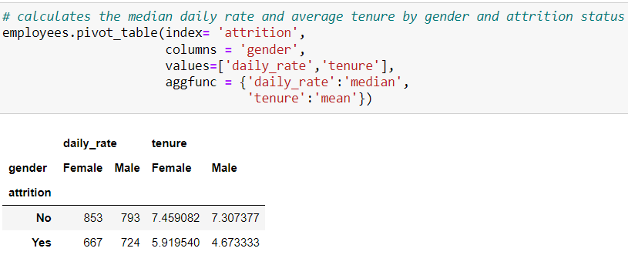
.pivot_table()
Can perform multiple aggregations on different values
.pivot_table() arguments
Calculates the Median Daily Rate and Average Tenure by Attrition Status and Gender
values = columns to aggregate
index = a column or columns which will be the pivot tables index
columns = a column or columns which will be the pivot tables columns
aggfunc = function to use for aggregating the values

Slide 41
Agenda
Introduction
Navigating a Data Frame
Exploring Your Data
Selecting Data
Cleaning Data
Data Visualizations
This Photo by Unknown author is licensed under CC BY-SA.

Slide 42
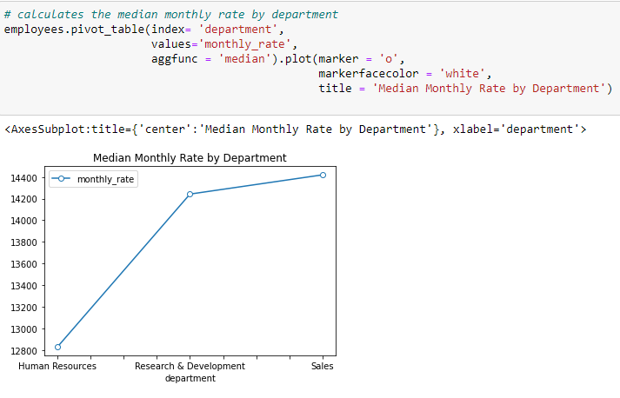
.plot()
Creates a line chart
.plot() arguments
Chain the pivot_table() Method with plot() to Create a Line Chart
x = values for the x-axis
y = values for the y-axis
title = plot titles
xlabel = label for the x-axis
ylabel = label for the y-axis
marker = marker style ex. Circle, stars, etc.
markerfacecolor = can set the marker color

Slide 43

.plot.pie()
Creates a pie chart
Use the autopct parameter to label your chart with the percentages
.plot() arguments
Chain the value_counts() Method with plot.pie() to Create a Pie Chart
x = values for the x-axis
y = values for the y-axis
title = plot titles
xlabel = label for the x-axis
ylabel = label for the y-axis
autopct = labels chart using percentages

Slide 44

.plot.bar()
Creates a bar chart
Use the color parameter to change the color of the bars
.plot() arguments
Chain the pivot_table() Method with plot.bar() to Create a Bar Chart
x = values for the x-axis
y = values for the y-axis
title = plot titles
xlabel = label for the x-axis
ylabel = label for the y-axis
color = color of bars
rot = rotation of the x-axis labels

Slide 45

.plot.bar()
Creates a stacked bar chart
Use the color parameter to change the color of the bars
.plot() arguments
Chain the pivot_table() Method with plot.bar() to Create a Stacked Bar Chart
x = values for the x-axis
y = values for the y-axis
title = plot titles
xlabel = label for the x-axis
ylabel = label for the y-axis
color = color of bars
rot = rotation of the x-axis labels
stacked = True creates a stacked bar chart

Slide 46


Thank you
Nicole Lettich
https://github.com/NicoleRL25/python_for_excel_users
https://www.linkedin.com/in/nicole-lettich/

